Slide 1
E-motion
Seth Van den Bossche

Slide 2


Slide 3
Frustratie
Emotie 1 – Week 1

Slide 4


Slide 5
Paniek
Emotie 2 – Week 2

Slide 6


Slide 7
Overwhelmend
Emotie 3 – Week 2

Slide 8
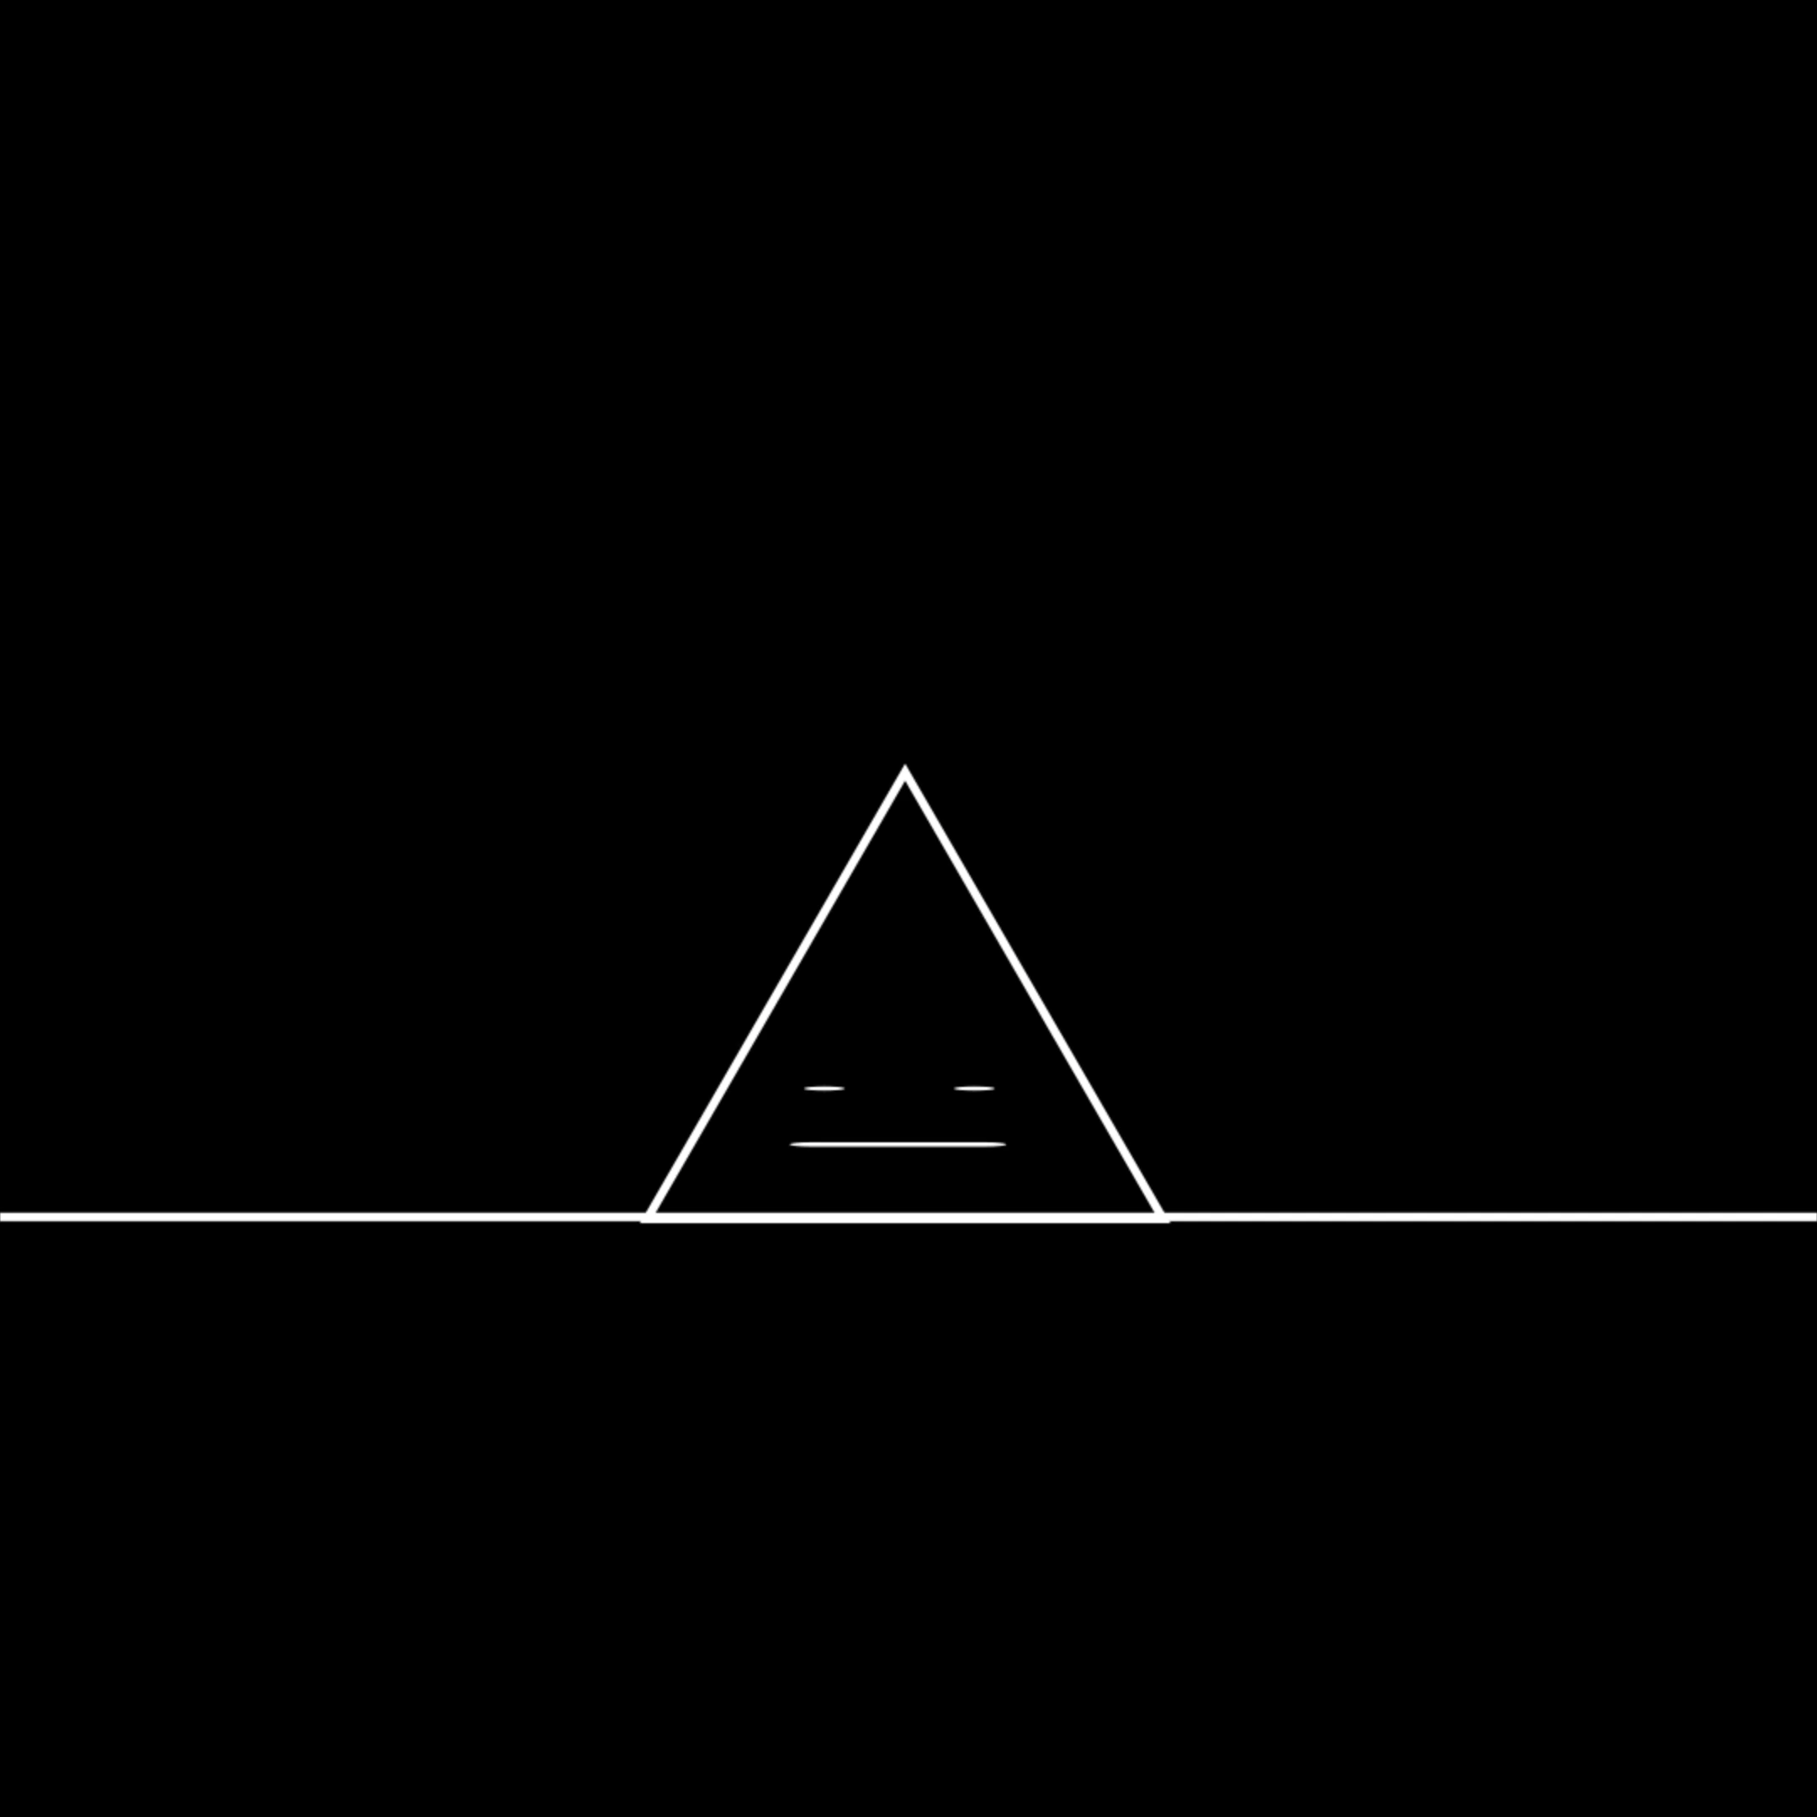

Slide 9
Nieuwsgierig
Emotie 4 – Week 3

Slide 10


Slide 11
Wereld stort in
Gevoel 5 – Week 3

Slide 12


Slide 13
Scrik
Emotie 6 – Week 3

Slide 14


